Slide 1
Microservices and DevOps
DevOps and Container Technology
Document-based NoSQL: MongoDB
Henrik Bærbak Christensen

Slide 2
The Mongo Shell
Mongo is a document based NoSQL.
A document is just a JSON object.
A collection is just a (large) set of documents
A database is just a set of collections.
MongoDB server is just a set of databases
JSON = JavaScript Object Notation
Actually BSON = binary encoded JSON
Mongo shell is a JavaScript interpreter!
(I have never coded in JavaScript, so…)

Slide 3
JSON
Get used to key/value pairs!
A simple document
{ course: ”MSDO”, semester:”E21”, students: 17 }

Slide 4
Basic commands…
MongoDB creates objects and collections in the fly…

Slide 5
find()
You can formulate simple queries using ‘find()’ on a collection.
db.collection.find(); Return cursor
Cursor = iterator pattern, type ‘it’ to continue iterating

Slide 6
find()
You use JSON objects to formulate queries
where ( _id == 733 )
AND
Ranges
Regular expressions
Counting .count();
Sorting .sort( criteria );
Limiting .limit( # );

Slide 7
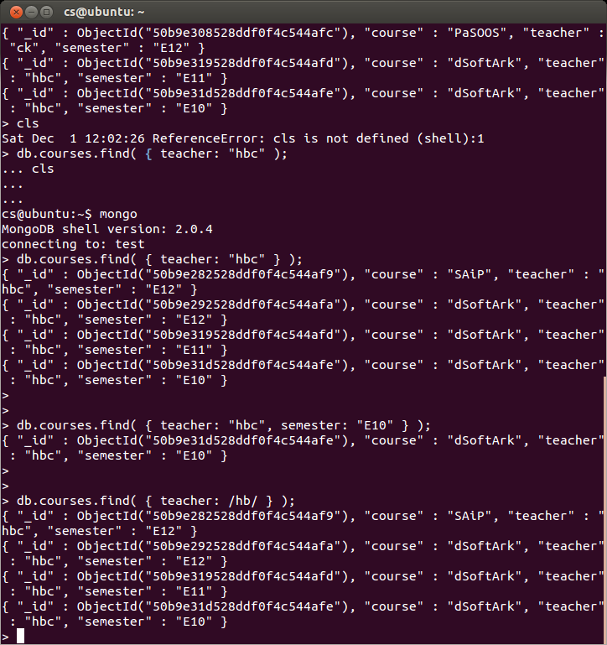
find()
You use JSON objects to formulate queries
”where” AND regexp

Slide 8
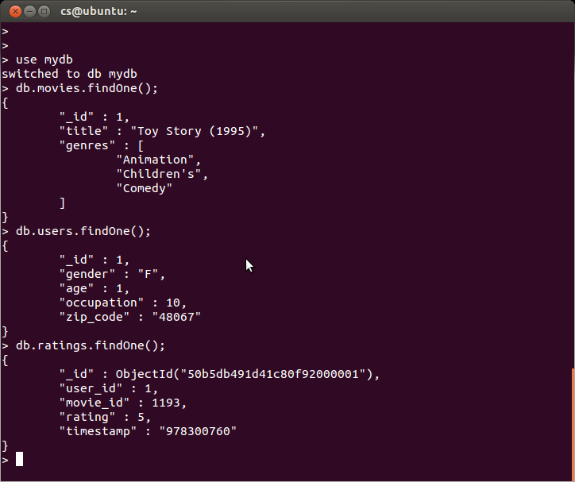
Switching databases
Let us switch to the database ‘movielens’
Movies Users Ratings
‘mydb’ in slides
Note: A much more OO like datamodel than RDB!
Arrays and nested objects!

Slide 9
Cursor functions
Counting Limiting

Slide 10
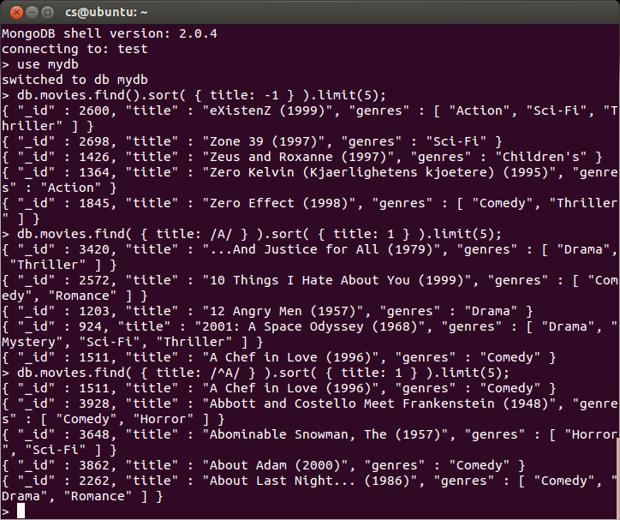
Sorting

Slide 11
Ranges?
Weird operators: $lt $ne etc…

Slide 12
Living without Join
Mongo does not have Join! (NoSQL have no join)
Select * from ratings r, movies m where r.movie_id = m._id AND m.title=”Nikita” AND r.rating=5 ☹
Then what?
One answer Denormalize
However, denormalizing is very dependent on query patterns
Here: put the ratings into the movie document

Slide 13
Living without Join
Then what?
Second answer Manual references (= join on client side!)
Find movie id using query 1; next find ratings using query 2
(§23.2.1 in MongoDB manual)
Third answer use DBRef (not NoSQL ☺)

Slide 14
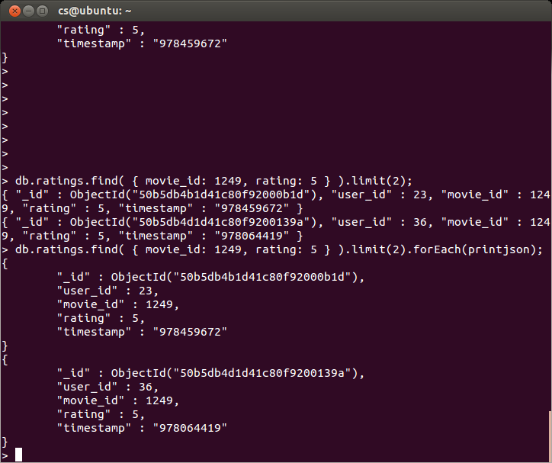
Functional features
Documents/cursors have methods, taking functions as parameters
cursor.forEach( function(value) { … } );

Slide 15
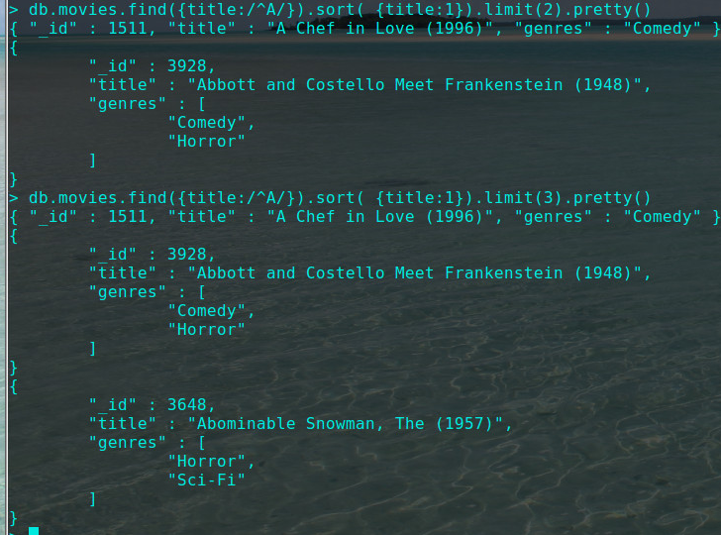
Nifty method
Which is identical to
pretty()

Slide 16
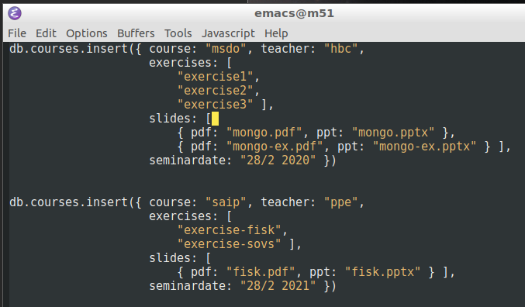
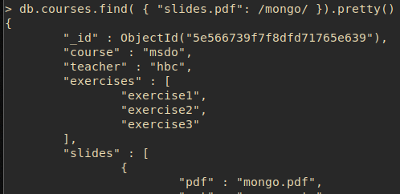
Finding within Substructure
Complex documents
Find all docs whose pdf slides contains ‘mongo’

Slide 17
Finding within Substructure
Complex documents
Find docs that have certain no. of exercises

Slide 18
And…
We mostly ‘play around’ without large datasets, but…
Queries are linear search unless you have indices…

Slide 19
Discussion
MongoDB is a Document database
Much better OO-like modeling compared to RDB
Advanced (and complex!) query language
(And what you learn now, cannot be carried over to the next NoSQL you may use ☹. Compare to learning SQL).
“Schema less”
Easy to get started, and hell once people start storing different versions of documents in the same collection ☹
Classic versioning handling tactics must be applied…
And you have to define schemas anyway, to demarshall the stored JSON correctly ☺

Slide 20
The Java API

Slide 21
The Good News
MongoDB is choosen for this course basically because their tutorial are pretty good

Slide 22
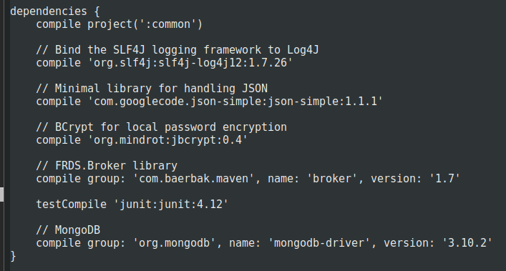
Getting the Driver
Help me Gradle ☺

Slide 23
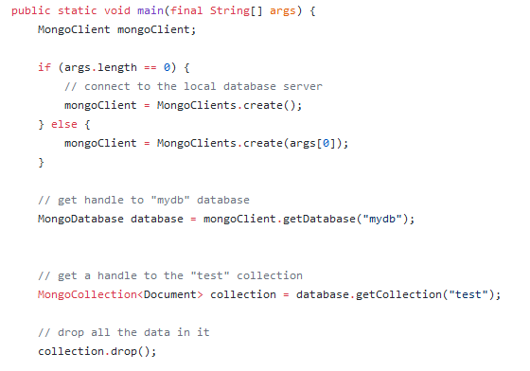
Initialization

Slide 24
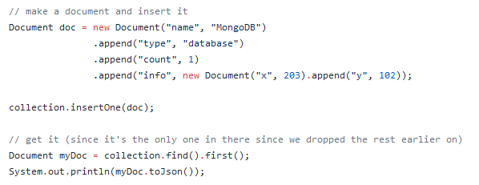
CRUD

Slide 25
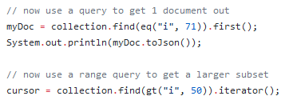
CRUD
Searching
Sorting

Slide 26
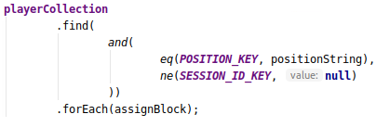
‘lambda’ like procesing
Apply Ops to each element in query: forEach()

